Slide 1
Privacy and Cyberspace I
Presented by:
Pablo Escobedo
Alonso Durazo
Jaylee Conlin
Fred Bumbarger
Michael Christiansen
Brandon Czaplicki
Harsh Damania

Slide 2
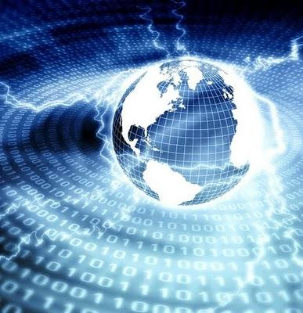
Cyberspace
Cyberspace is the abstract environment containing networked computer data
So important that the U.S. defines it as Critical Infrastructure (essential to society and the economy)

Slide 3
Privacy
Privacy is the state of being free from outside observation or interruption (spyware vs. email)
Privacy in computing mostly relates to information privacy
Sharing information while protecting personal data is the main challenge

Slide 4
Privacy and Cyberspace
Areas of Concern:
Judicial Documents (Criminal records, etc.)
Financial Records
Healthcare Information
Generally:
Personally identifiable information

Slide 5
Topics Covered Today
Today, we will be discussing:
Spam and Email
Spying Software
Publicly Available Government Data
RFID
Computer Merging

Slide 6
Spam / Email

Slide 7
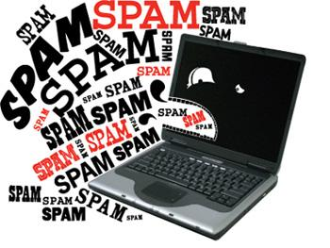
What is "Spam"?
Unsolicited bulk emails sent to numerous recipients
Most of them used for propaganda
Often contain links to malicious websites
The term "spam" is derived from a Monty Python sketch.

Slide 8
First case of spam on email
Sent by Gary Thuerk in 1978 on ARPAnet.
The message contained an invitation to a sales presentation for the DEC 2020.
Sent to approximately 400 people.
Nowadays, over 2 billion spam messages are sent each day.

Slide 9

How to deal with spam
Do not enter your email address into a strange website.
In case of receiving email spam, it will probably be in the junk email folder.
Do not click the links inside the spam email.
Report the email address of the sender.

Slide 10
Spying Software
He's climbin' in yer windows, snatching yer info up.

Slide 11
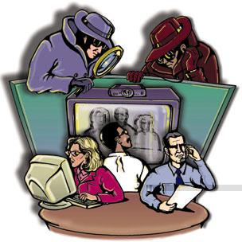
What is Spyware?
A kind of software that:
-Collects personal info
-Changes configuration of computer
-Usually done without one's consent
Notes:
kind of info is usually banking information, credit card info, passwords,

Slide 12


How do they do it?!
1) Drive-by download
-program automatically downloads to computer
w/o your knowledge
2) Pop-up window
-deceptive little things that make you wanna click buttons

Slide 13
Adware: The Biggest Culprit
-Anyway application in which an ad is displayed while program is running
-Companies use this to keep costs down
-Usually includes code that tracks the user's personal info and sends it to third parties w/o consent

Slide 14
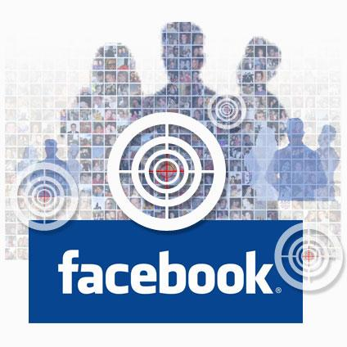
So, when is it not Spyware?
Keywords here are consent and understanding!
A lot of adware is used for marketing purposes.
Do you ever read the License Agreement?

Slide 15
Is this even legal?! Well...
-'I accept the terms and conditions...'
-Some US states make it illegal to monitor keystrokes or disable security settings
Is it ethical?
Sure doesn't feel like it...

Slide 16
Publicly Available Government Data

Slide 17
Open Government
During President Obama's first full day of work on January 21, 2009, he issued an executive memorandum that instructed the chief technology officer, in coordination with the agency heads to recommend provisions for an open government directive that would leverage new technologies.

Slide 18
The first major assignment
Publish at least three new downloadable sets of statistics that hold the government accountable, showcases their work, share financial opportunities or any other need conveyed by citizens.

Slide 19
Ethics
The idea of allowing this information to be public is that the government can be held more accountable when it is transparent.
This accountability will help to ensure ethical practices of our government by those who are accessing the Public Sector Information. (PSI)

Slide 20
Generally put online for three reasons:
Generally put online for three reasons:
Generally put online for three reasons
Increase citizen awareness of government functions that enable greater accountability.
Contributes valuable information about the world.
Enables the Government, the country, and the world to function more efficiently.

Slide 21
Benefits
Third-party applications are built around the joined data sources to meet public needs.
Example: FixMyStreet
mysociety.org has an application called FixMyStreet that will take reports of cracks, potholes and anything else dangerous about your road and report it to the correct department and will give details about previous reportings.

Slide 22
Departments required to release the new data sets.
Departments of:
State
Treasury
Defense
Justice
Interior
Agriculture
Services

Slide 23
Cont.
Housing and Urban Development
Transportation
Energy
Education
Veterans Affairs
Homeland Security
Environmental Protection Agency

Slide 24
Data sets are located at
www.Data.gov

Slide 25
RFID

Slide 26
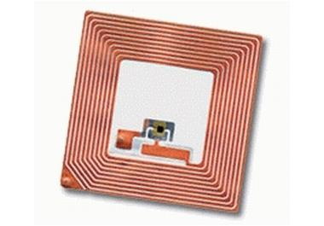
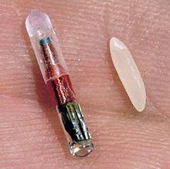
What is RFID
Radio frequency identification
  Used to transfer data
  Tracking
  Identification
Design
  Tags
  Decryption

Slide 27
Types of RFID
Three main types
  Active
    Internal power supply
    Able to broadcast a signal
  Passive
    Use the signal from the transmitter to power the circuit
  Semi passive
    similar to passive but battery only powers the circuit

Slide 28
Example of RFID
Payment (NFC)
  Cellphones
  Credit cards
Inventory
  Wal-mart
  Boeing
  Best Buy
Identification
  Livestock
  People

Slide 29
Controversial uses of RFID
Used in passports, Identification cards
  since 2006 US passports
FDA approves implantations in humans
  night clubs
Use in hospitals
  Track equipment
  Patients in emergency rooms

Slide 30
"Skimming"
The process of taking information off of RFID without consent
Can easily be done
  In 2009 Chris Paget
    Drove around San Francisco with a motorola reader, antenna and laptop
    Within twenty minutes skimmed passports, pass cards, and driver license
  2012
    At Shmoocon security researcher Kristian Pagent showed again how easy to take credit card number and put on a blank card

Slide 31
Computer Merging

Slide 32
What is it?
Merge data into one database
Database can be accessed by many users
  Every change that is made to a file creates two copies of the file, each stored in the database.

Slide 33
Role in ethics
Computer merging not an ethical issue itself, only how it can be used
Databanking
  collection of data located in a database that can be accessed by third-party members
  Credit-card transactions, ID information, etc.
Cookies
  Tracks your internet activity
  Used for advertisment

Slide 34
Example
Facebook facial recognition software
  Facebook uses their tags in photos to track an individual's shopping pattern where the software is present
Is this ethical?
EU bans Facebook from using this software, forces Facebook to delete all european databases.

Slide 35
Role in ethics contd.
While storing information is not wholly unethical, the purpose of the information may be in question
  Subject usually does not know if they are being tracked, or who is tracking them

Slide 36
Computer Matching and Privacy Protection Act
The Computer Matching and Privacy Protection Act of 1988 (5 U.S.C. 552a(o) et seq.) amended the Privacy Act by describing the manner in which computer matching involving Federal agencies could be performed and by adding certain protections for individuals applying for and receiving Federal benefits.
As amended by the Computer Matching and Privacy Protection Act, the Privacy Act requires Federal agencies involved in computer matching programs to:
1. Negotiate written agreements with the other agency or agencies participating the matching programs;
2. Obtain the relevant Data Integrity Boards' approval of the match agreements;
3. Furnish detailed reports about matching programs to Congress and OMB;
4 Notify applicants and beneficiaries that their records are subject to matching; and
5 Verify match findings before reducing, suspending, terminating, or denying an individual's benefits or payments.

Slide 37
Conclusion
Wrapping it up!

Slide 38
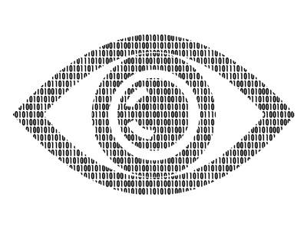
Cyberspace and Privacy
Cyberspace is the abstract environment containing networked computer data.
Privacy is a personal, subjective condition. It is the state of being free from outside observation or interruption.

Slide 39
Looking back
em@ail spam meets the following criteria
Anonymity: The address and identity of the sender are concealed
Mass Mailing: The email is sent to large groups of people
Unsolicited: The email is not requested by the recipients

Slide 40
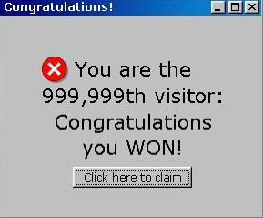
Spyware - Is anything that collects user information without consent and changes computer configuration. Biggest threat is adware.
Publicly Available Government Data - Available public to make the government more accountable and to increase awareness to the public.
Looking back

Slide 41
Radio Frequency Identification(RFID) - used for data transfer, tracking and identification.
These little chip and antenna devices could read data from long ranges without consent and one could really question whether it is ethical to use such devices or not, even though it has a lot of advantages backing it.
Computer Merging - It is the merging of data from a collection of databases. Uses question its ethical nature.
Looking back

Slide 42
References
http://en.wikipedia.org/wiki/Email_spam
http://email-museum.com/2011/10/06/first-spam-was-in-1978/
http://2.bp.blogspot.com/-ScXRzMHXRrc/T9VxSuE0g-I/AAAAAAAAAvA/E-NAziyR7p8/s320/spyware.jpg
http://www.microsoft.com/security/pc-security/spyware-whatis.aspx
http://searchcio-midmarket.techtarget.com/definition/adware
http://www.spychecker.com/spyware.html
http://searchsecurity.techtarget.com/definition/spyware
http://thedailyzoom.com
http://folar.org/wp-contentuploads/2011/04/click-here.jpg
http://www.comodo.com/resources/home/spyware-trojans.php
http://www.americanbar.org/newsletter/publications/gp_solo_magazine_home/gp_solo_magazine_index/spywarelegalethicalimplications.html
http://www.bullguard.com/bullguard-security-center/pc-security/computer-security-resources/spyware-and-legal-issues.aspx
http://georgewbush-whitehouse.archives.gov/pcipb/
http://www.w3.org/DesignIssues/GovData.html
http://www.huffingtonpost.com/2010/01/22/government-data-released_n_432632.html
https://explore.data.gov/ethics/learn-more

Slide 43
More References
•http://www.foxnews.com/story/0,2933,531720,00.htm
•http://www.practicalhacks.com/2011/05/02/keep-your-rfid-passport-data-secure/
•http://money.howstuffworks.com/atm-skimming2.htm
•http://www.pcworld.com/article/249138/rfid_credit_cards_are_easy_prey_for_hackers_demo_shows.html
•http://www.computerworld.com/s/article/9109139/Chip_maker_sues_to_quash_research_on_RFID_smart_card_security_flaws?taxonomyId=85&pageNumber=2
•http://www.techdirt.com/articles/20080901/1816502143.shtml
•http://www.datamars.com/default.aspx?menuitemid=258&menusubid=14&AspxAutoDetectCookieSupport=1
•http://upload.wikimedia.org/wikipedia/commons/thumb/c/c7/Microchip_rfid_rice.jpg/220px-Microchip_rfid_rice.jpg
•http://en.wikipedia.org/wiki/Radio-frequency_identification#cite_note-46
http://smallbiztrends.com/wp-content/uploads/2011/02/rfid-large.jpg
http://4.bp.blogspot.com/_lpT5VbPe0pc/SztWp9XjeII/AAAAAAAAAtU/ut9ck-1Cd9Q/s400/bigstockphoto_internet_world.jpg
http://www.privacilla.org/government/cmppa.html
http://web.simmons.edu/~chen/nit/NIT'96/96-025-Britz.html
http://www.acs.ilstu.edu/staff/parmenter/ITK214/Privacy_and_Personal_Information_p1.pdf

